Slide 1
CpE111
Introduction to Computer Engineering
Dr. Minsu Choi
CH 7: Logic Components

Slide 2
Digital Logic Component Concept
It is very difficult to keep track of each gate in designing a large digital system such as a computer.
The hierarchical design approach where a large (“macro”) function is defined using a large block is called a digital component (= element, unit or module).
Ex)

Slide 3
4-Bit Equality Detector
Suppose that we have two 4-bit words
That we wish to compare.

Slide 4
BCD Validity Detector
Bit patterns from 0000 to 1001 are used.
How can we design a detector?
If (ABCD is valid) then F=0 else F=1.
Let’s build a K-map!

Slide 5
Line Decoders
Line decoder is a circuit that allows us to “activate” an output line by specifying a control word.
Ex) Active-high 2/4 decoder

Slide 6
Active-Low 2/4 Decoder

Slide 7
Multiplexer (MUX)
A MUX is a logic component that has several inputs but only a single output. It provides the capability to direct one of the inputs to the outputs.
Ex) 4:1 MUX

Slide 8
4:1 MUX: Internal Circuitry and IEEE Symbol

Slide 9
8:1 MUX
Internal circuitry will be very complex.
2 4:1 MUXs & 1 2:1 MUX can be combined to implement 8:1 MUX.
-> Hierarchical design approach.

Slide 10
Continued,
The select word s₂s₁s₀ can be split into two groups: s₁s₀ to control the 4:1 MUXs and s₂ to select a desired output from them.
Two internal signal x₁ and x₂ can be defined as:
Then,

Slide 11
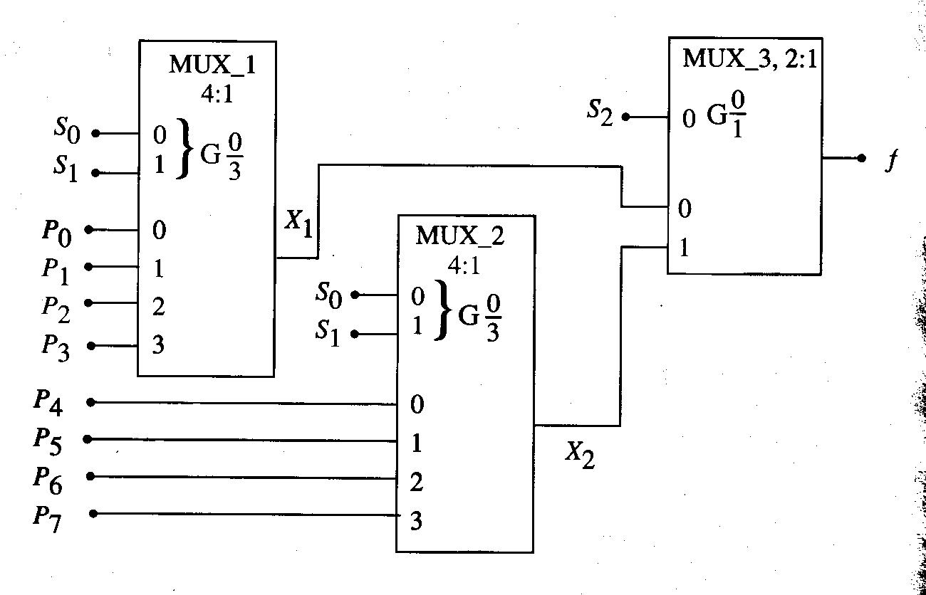
Completed 8:1 MUX Design

Slide 12
MUXs as Logic Elements
A MUX can be programmed to function as a logic element.
Ex) 4:1 MUX OR implementation.

Slide 13
Continued,
Ex) XOR
Ex) XNOR

Slide 14
VHDL Description of 4:1 MUX
entity mux4 is
port(d0, d1, d2, d3: in bit; s : in bit_vector(1 downto 0); f : out bit);
end mux4;
architecture basic of mux4 is
begin
f<=d0 when (s=“00”) else
f<=d1 when (s=“01”)
else
f<=d2 when (s=“10”)
else
f<=d3 when (s=“11”)
end basic;

Slide 15
Demultiplexer (DEMUX)
A DEMUX is the opposite of a MUX. It takes a single input and directs it to one of several outputs.
Ex) 1:4 DEMUX

Slide 16
VHDL Code
entity demux1_4 is
port(x: in bit; s: in bit_vector(1 downto 0); p0,p1,p2,p3 : out bit);
end demux1_4;
architecture operation of demux1_4 is
begin
if s=“00” then
p0<=x;
p1<=‘0’;
p2<=‘0’;
p3<=‘0’;
else if s=“01” then
…
end operation;

Slide 17
Binary Adders
Arithmetic functions such as addition and subtraction can be performed using binary numbers. These types of operations are central to building a computer.
4 cases can be identified for 1-bit addition:
  0 + 0 = 0
  0 + 1 = 1
  1 + 0 = 1
  1 + 1 = 0 with a carry of 1 (called “carry bit”)
The output column is equivalent to XOR function.

Slide 18
Full Adder
A logic network that provides the operations needed to add the bits in an arbitrary column.
3 input bits: a_{n}, b_{n} (data bits) and c_{n} (carry-in bit from the column immediately to the right).
2 output bits: s_{n} (sum bit) and c_{n+1} (carry-out bit).

Slide 19
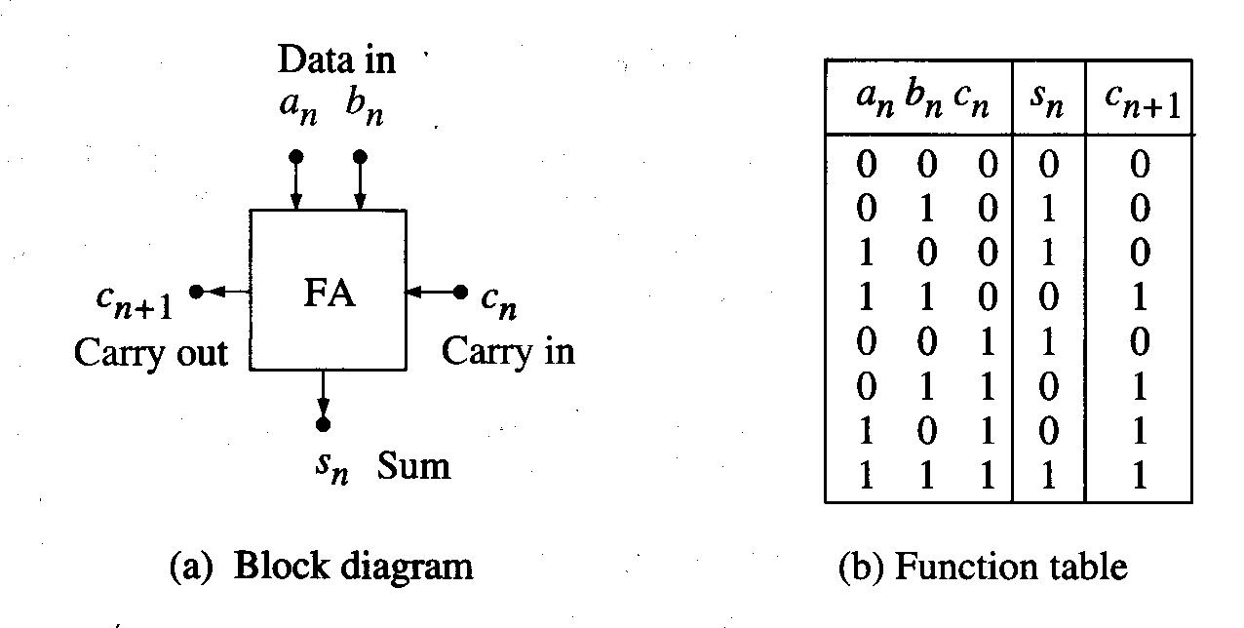
Block Diagram and Truth Table

Slide 20
Simplified Function Forms of s_{n} and c_{n+1}

Slide 21
Half Adder
A special case of the full adder when c_{n}=0 (no carry-in bit considered).

Slide 22
Parallel Adders
Half-adders and full-adders are used to add individual bits together. An extension of this problem is the addition of two n-bit binary words.
Ex)
This shows that we can use a single-bit adder for each column and connect the carry-out bit to the adjacent column to the left.

Slide 23
Overflow Bit
Also note that the sum may be larger than 4 bits.
So, an overflow bit c_{o} is provided such that c_{o} =0 means that 4 bits are sufficient to express the sum, while c_{o} =1 implies that the sum requires more than 4 bits.
Ex)

Slide 24
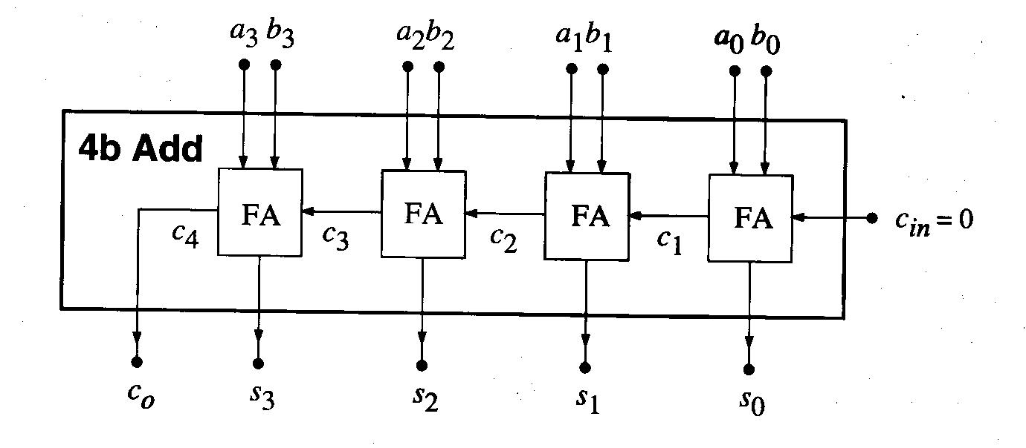
Parallel Adder Design with Ripple Carry Scheme
The carry “ripples” from the right to the left.

Slide 25
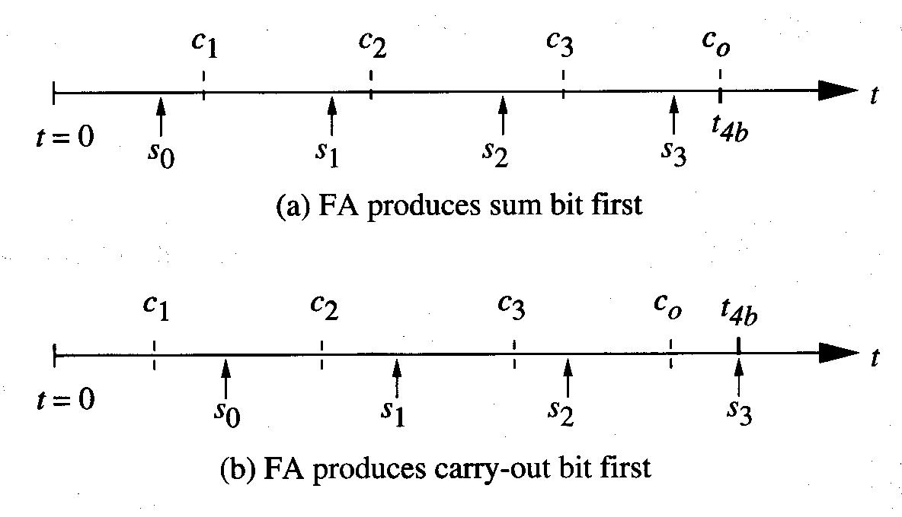
Timing
There are two cases we must consider:
  FA generates s first, then c.
  FA generates c first, then s.

Slide 26
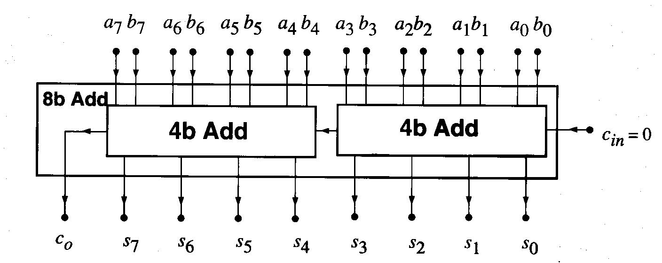
8-Bit Adder Design using Cascaded 4-Bit Adders
Likewise, 16-bit or more can be designed.

Slide 27
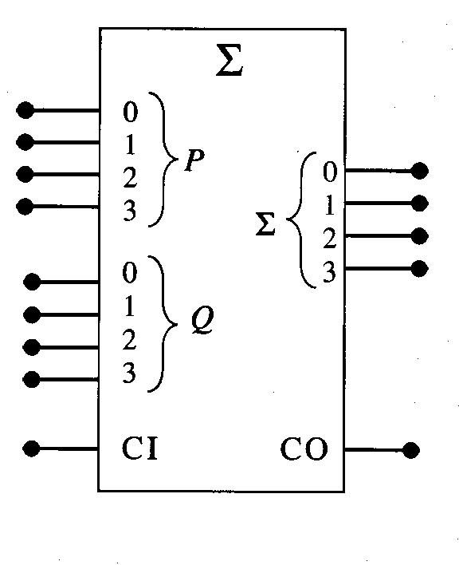
IEEE Adder Symbol
P: input word 1
Q: input word 2
Sigma: output word
CI: carry-in bit
CO: carry-out bit

Slide 28
Subtraction
It is more complex since we need to “borrow”.
Ex)
Very hard to implement with digital network.

Slide 29
More Efficient Way?
X – Y = D is equivalent to saying that X + (-Y) = D where Y + (-Y) = 0.
So, we can find (-Y). Then, using the adder, add X & (-Y) to perform subtraction.
Ex)

Slide 30
1’s Complement and 2’s Complement
Then, how we can express (-Y) in binary?
2’s complement number can be used.
  First, complement each bit: called 1’s complement.
  Then, add 1 to it: called 2’s complement.
  Y + 2’s complement Y = 0, if we discard overflow bit.
  So, (X – Y) = X + 2’s complement Y -> we can use the adder to perform subtraction.
Ex) X = 0101 and Y = 0011. Then, (X – Y) = ?

Slide 31
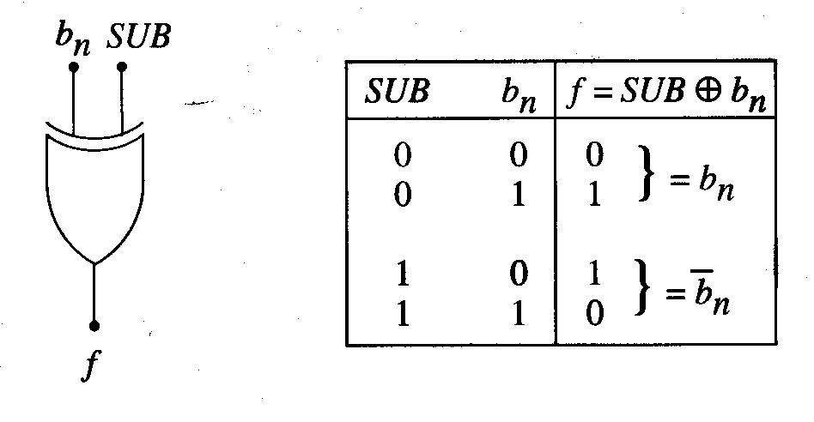
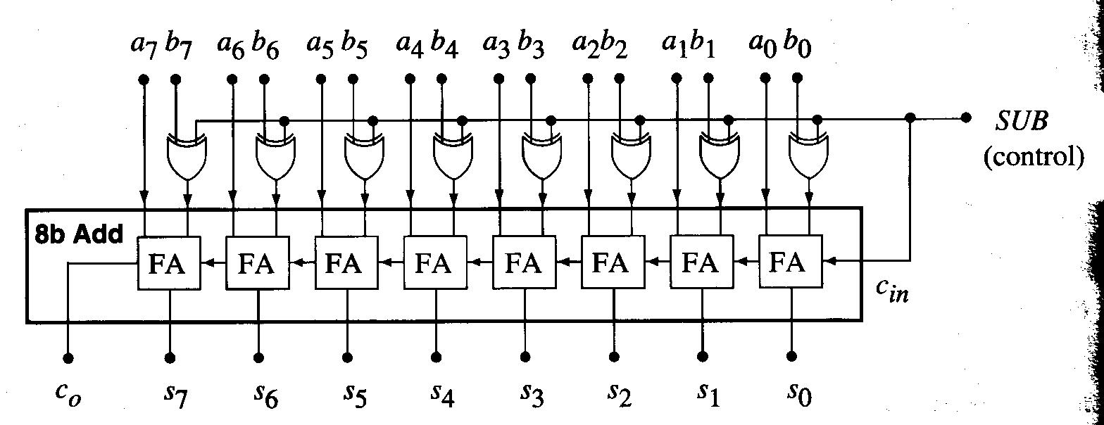
Subtraction Logic Circuit
XOR gate can be used to generate 1’s complement number.
C_{in} must be 1 so that we add 1 to 1’s complement to make 2’s complement.

Slide 32
Positive and Negative Integers in 2’s Complement
n-bit binary word has 2^n bit patterns.
The total number of bit patterns is divided into two groups.
If MSB is 0, positive integer.
If MSB is 1, negative integer.
So MSB is also called as “sign bit”.
Since all-zero bit pattern is used to represent 0, the range of positive values is one less than the range of negative values.
For example, 8-bit 2’s complement word has 256 bit patterns. So, it is possible to express -128₁₀ to +127₁₀.

Slide 33
8-Bit 2’s Complement Number
The MSB is used as sign bit of -2^7 weight and the other bits have weight of 2^i.
Ex)

Slide 34
Multiplication
AND function can be used to implement 1-bit multiplication.
For multi-bit multiplication, 1-bit multiplier and HA can be used.
Ex) 2-bit multiplication

Slide 35
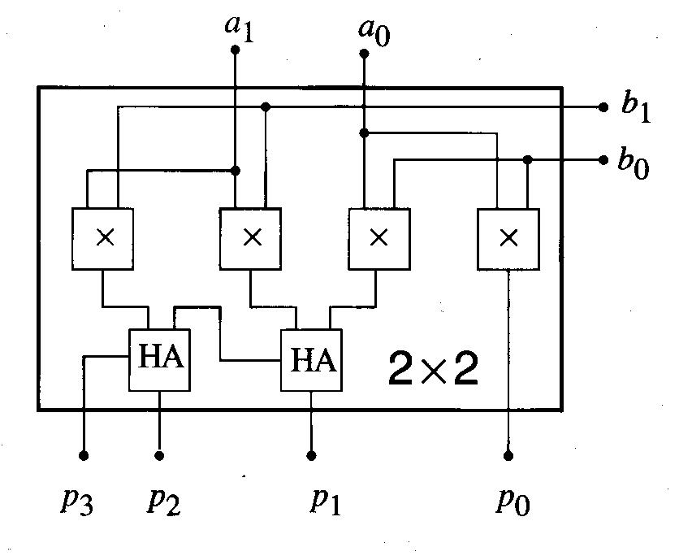
2-Bit Multiplier Internal Circuitry

Slide 36
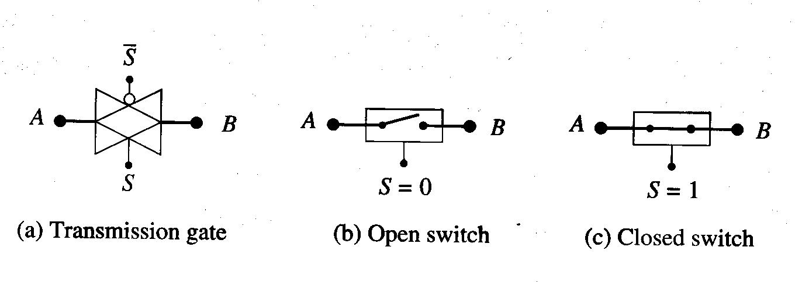
Transmission Logic Gate
TGs are logic-controlled switches that can be used to construct a wide variety of logic networks.
CMOS TG has very simple structure:

Slide 37
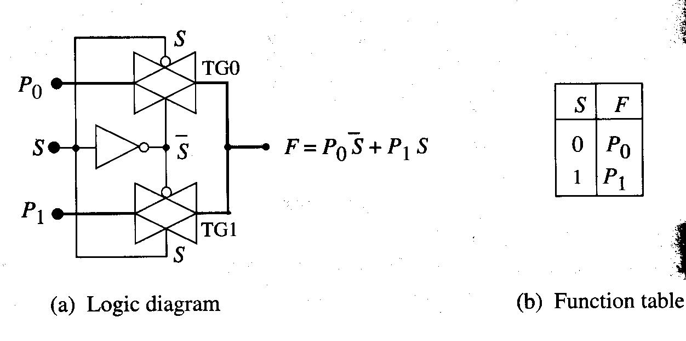
2:1 MUX using TGs

Slide 38
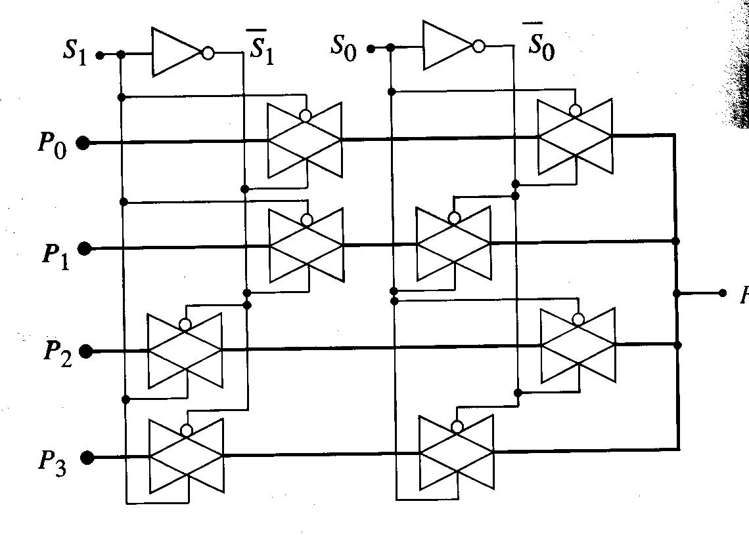
4:1 MUX using TGs

Slide 39
TG XOR and XNOR Gates

Slide 40
Program Completed
University of Missouri-Rolla
© 2003 Curators of University of Missouri

